Slide 1

Parsing
Left Recursion and Left Factoring

Slide 2
Why use Context Free Grammars
Every construct that can be described by a regular expression can be described by a grammar, but not vice-versa. Alternatively, every regular language is a context-free language, but not vice-versa.

Slide 3
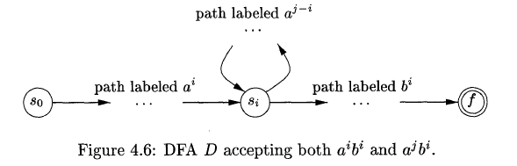
L={ a^{n}b^{n} | n≥1}
Show that L can be described by a grammar not by a regular expression
Construct a DFA D with k states to accept L
For a^{n}b^{n} (n>k) some state (s_{i}) of D must be entered twice
…
…
S₀
f
Path labeled a^{m}b^{n}
Notes:
Finite automata cannot count

Slide 4

Left Recursion – Why is it bad
A grammar is left recursive if it can be represented in the form:
Why is this a problem for top down parsing?

Slide 5
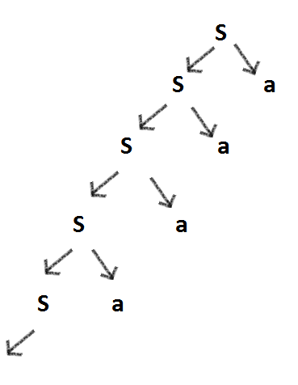
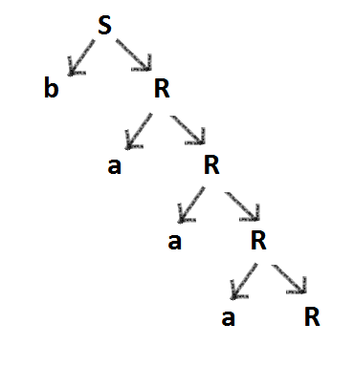
Left Recursion – Why is it bad
Example:
Left recursive grammar S -> Sa | b To derive baa: | Equivalent Right Recursive grammar S -> bR R -> aR | €

Slide 6


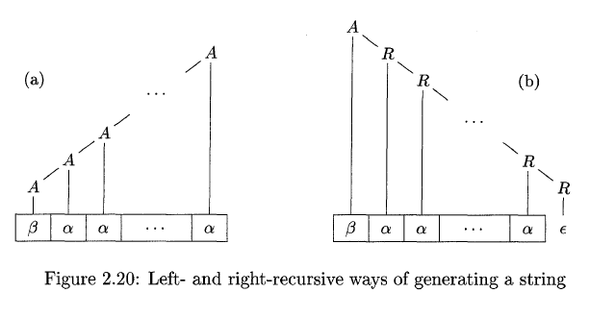
Left and Right Recursive Grammar
(a)
(b)
Notes:
Grammar (b) is the equivalent grammar of grammar (a) but in right recursive form

Slide 7
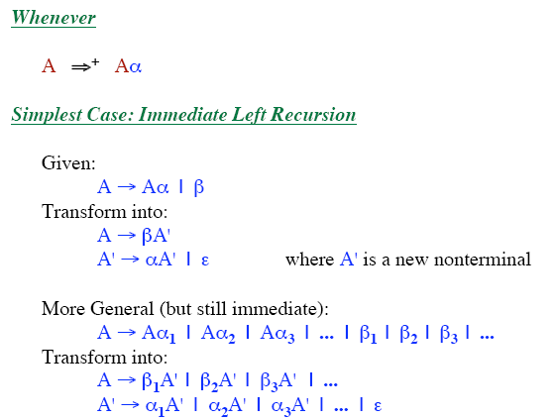
Left Recursion Removal

Slide 8
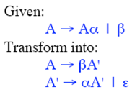
Immediate Left Recursion Elimination: example
Grammar
  E → E + T | T
  T → T * F | F
  F → ( E ) | id
Left recursion Eliminated (step 1)
  E → T E‘
  E' → + T E' | ε

Slide 9
Immediate Left Recursion Elimination: example
Grammar
  E → E + T | T
  T → T * F | F
  F → ( E ) | id
Left recursion Eliminated (step 2)
  E → T E‘
  E' → + T E' | ε
  T → F T'
  T' → * F T' | ε

Slide 10
Immediate Left Recursion Elimination: example
Grammar
  E → E + T | T
  T → T * F | F
  F → ( E ) | id
Left recursion Eliminated (step 3)
  E → T E'
  E' → + T E' | ε
  T → F T'
  T' → * F T' | ε
  F → ( E ) | id

Slide 11
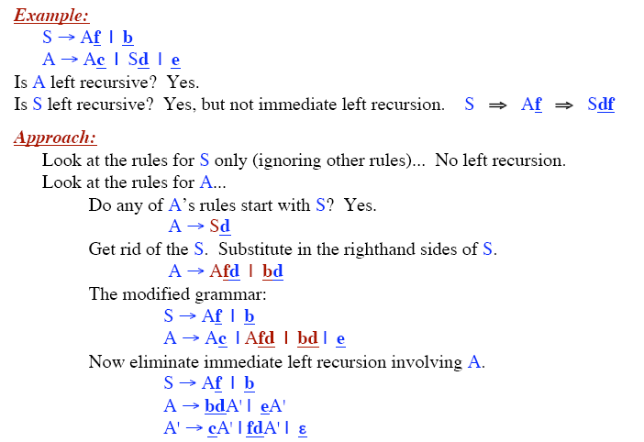
Left Recursion in More Than One Step

Slide 12
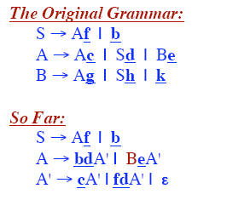
Left Recursion in More Than One Step

Slide 13
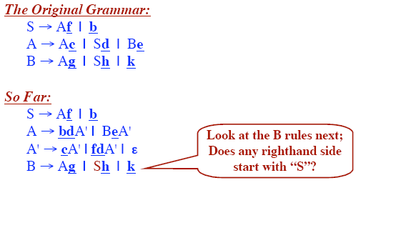
Left Recursion in More Than One Step

Slide 14
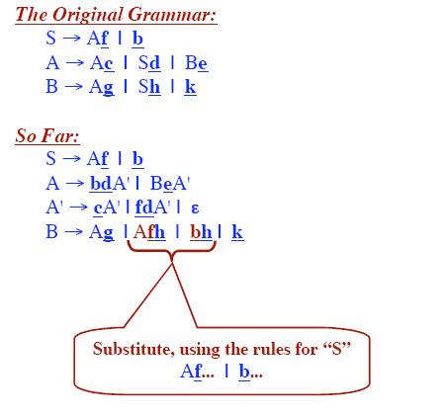
Left Recursion in More Than One Step

Slide 15
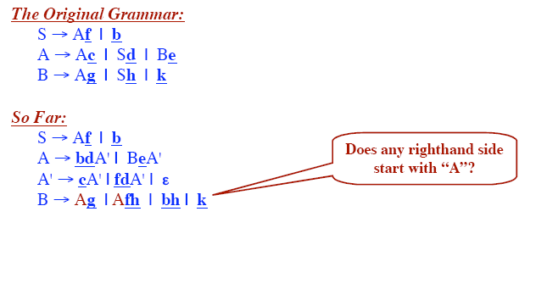
Left Recursion in More Than One Step

Slide 16
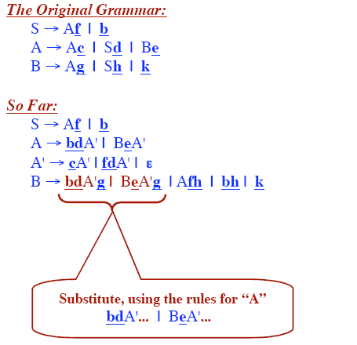
Left Recursion in More Than One Step

Slide 17
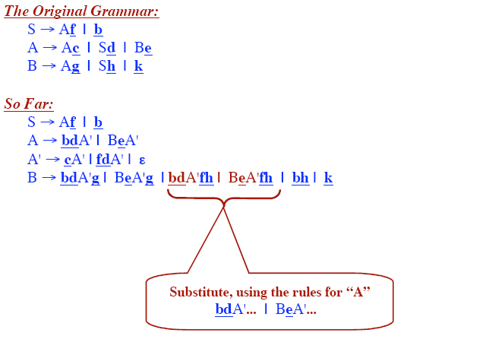
Left Recursion in More Than One Step

Slide 18
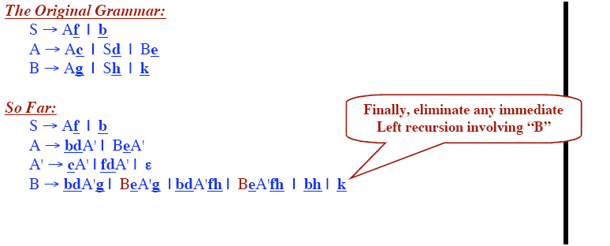
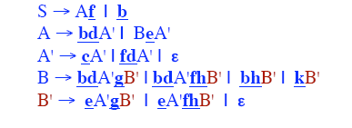
Left Recursion in More Than One Step
Next Form

Slide 19
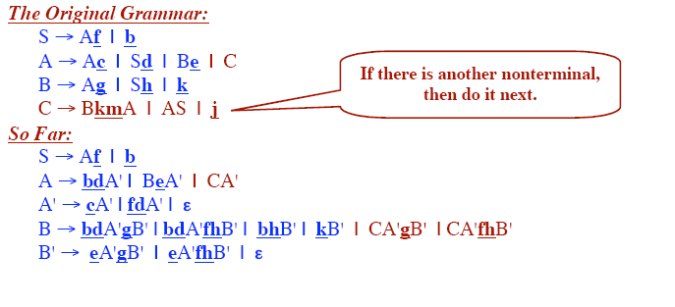
Left Recursion in More Than One Step

Slide 20
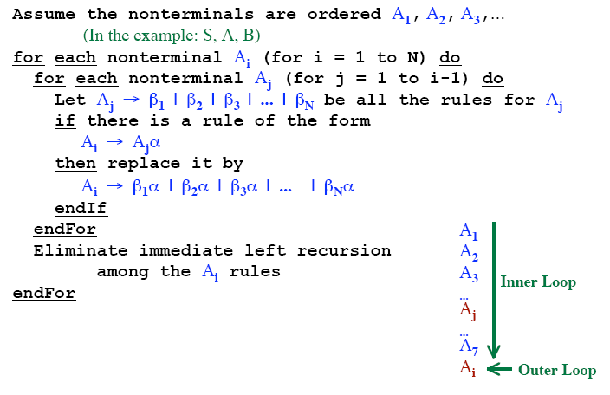
Algorithm for Eliminating Left Recursion

Slide 21

Left Factoring
Consider the following grammar:
Suppose a top down parser is trying to generate the string: ibtaea
How will a top down parser work?
Remember that a parser has limited look ahead symbols (1 look ahead usually)

Slide 22
Left Factoring
S
Given string: ibtaea

Slide 23
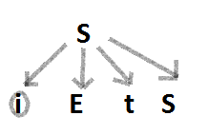
Left Factoring
Given string: ibtaea

Slide 24
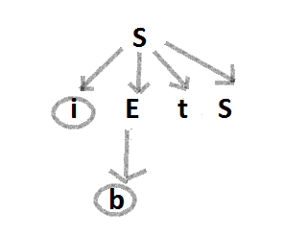
Left Factoring
Given string: ibtaea

Slide 25
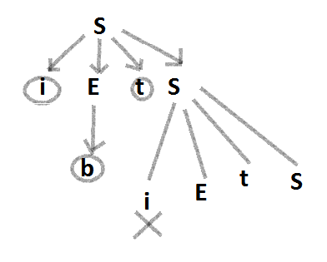
Left Factoring
Given string: ibtaea

Slide 26
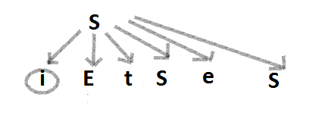
Left Factoring
Given string: ibtaea

Slide 27
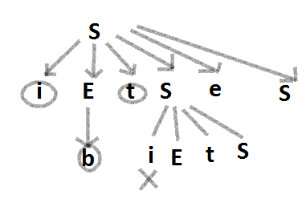
Left Factoring
Given string: ibtaea

Slide 28
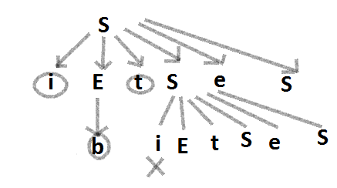
Left Factoring
Given string: ibtaea

Slide 29
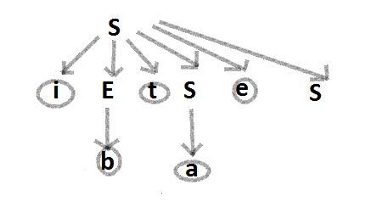
Left Factoring
Given string: ibtaea

Slide 30
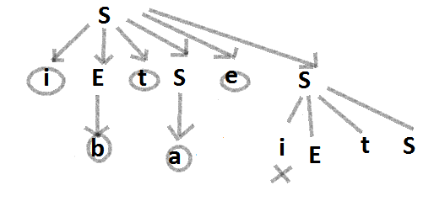
Left Factoring
Given string: ibtaea

Slide 31
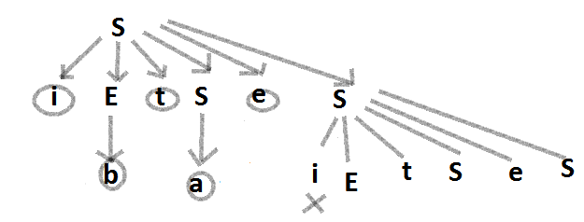
Left Factoring
Given string: ibtaea

Slide 32
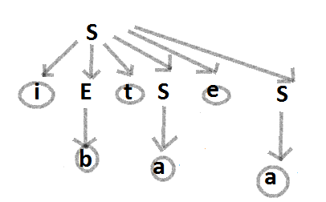
Left Factoring
Given string: ibtaea

Slide 33

Left Factoring
So to eliminate the problem of generating the same grammar string multiple times, take a common grammar string and factor it out:
Given Grammar:
Left Factored Equivalent of the grammar:

Slide 34
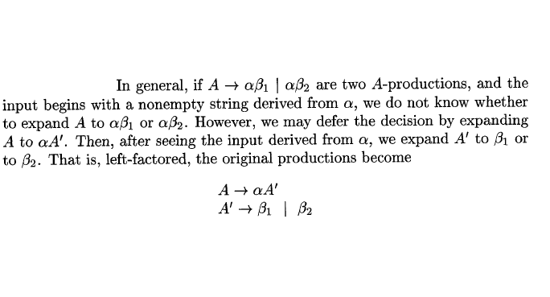
Left Factoring

